Slide 1
Nanomaterials
Condensed Matter Physics
Mid Term INNOVATIVE Project
Submitted to : Dr. M Jayasimhadri
Students Name: Aditya Singh 2K19/EP/005
Anshul Satija 2K19/EP/018

Slide 2

Definition
The term ‘nano-material’ usually implies that one or more of the components which make up the material are nanosized. Nanostructures are the structures, whose sizes are within a few nanometers (<100 nm) and can comprise of either single material or multiple material.

Slide 3
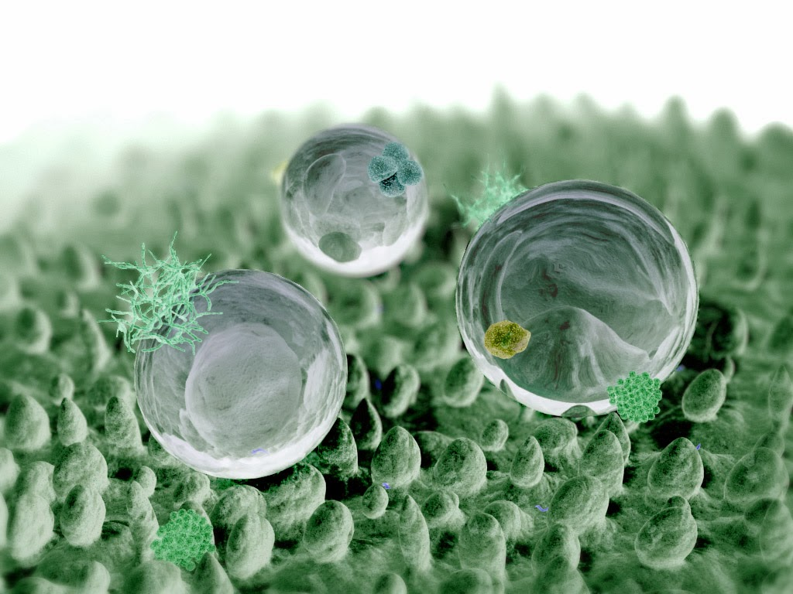
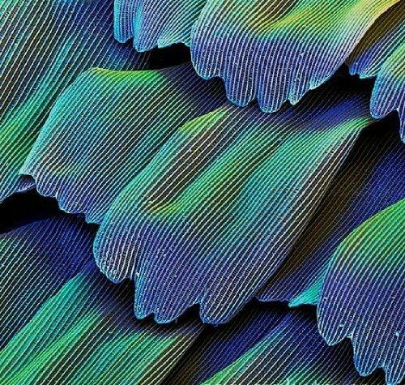
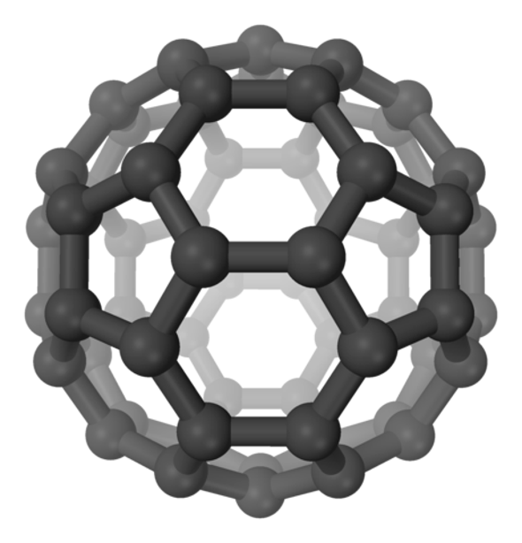
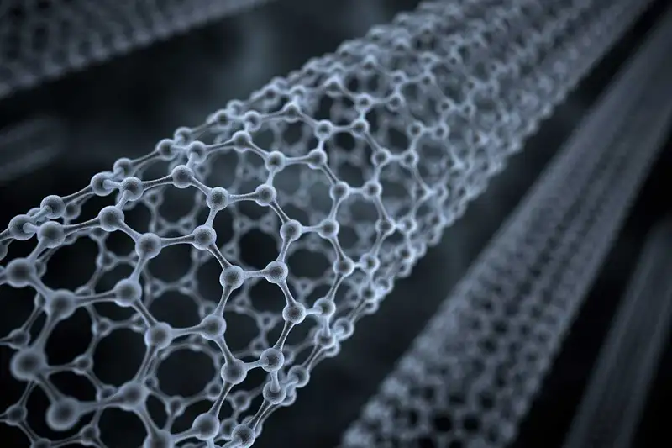
Nanomaterials around us
Nature has many examples of nanostructures such as hydrophobic leaves, iridescent butterfly wings, and the gecko’s foot.
Sphere-like particles: Ag nanoparticles, buckyballs
Rod-like particles : Si & Ni nanowires.
Tube-like particles: Carbon nanotubes, TiO2 nanotubes

Slide 4
Why Nanomaterials are important
The study of nanomaterials has extended the frontiers of science and has warranted the existence of a new domain of research called nanoscience.
Nanotechnology is the application of the principles of nanoscience into useful deliverables. This includes the application of nanostructures/nanomaterials into useful nanoscale devices and components.
Concepts of nanoscience, nanotechnology aims at improving the lifestyle of the human race. Due to the ability to generate the materials in a particular way to play a specific role, the use of nanomaterials spans across various industries, from healthcare and cosmetics to environmental preservation and air purification.

Slide 5
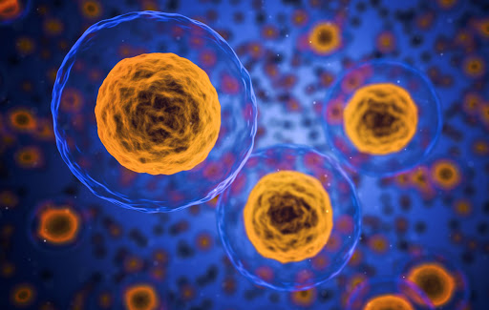
Properties
Size
Structure
Melting Point
Optical Properties
Electrical Properties
Scattering

Slide 6
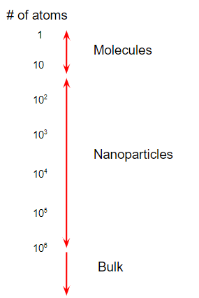
SIZE
Molecules, nanoparticles, and bulk materials can be distinguished by the number of atoms comprising each type of material.
Nanoparticles exhibit unique properties due to their high surface area to volume ratio.
As the percentage of atoms at the surface increases, the mechanical, optical, electrical, chemical, and magnetic properties change.
Nanoparticles exhibit unique properties due to their high surface area to volume ratio.

Slide 7
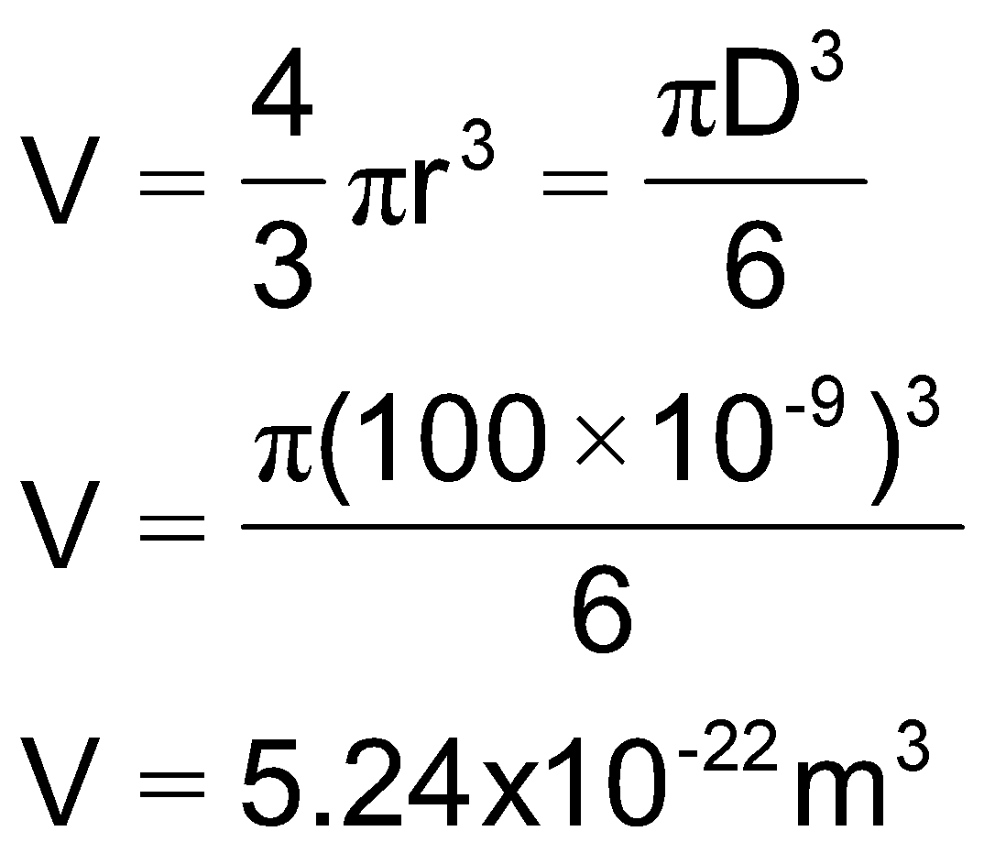
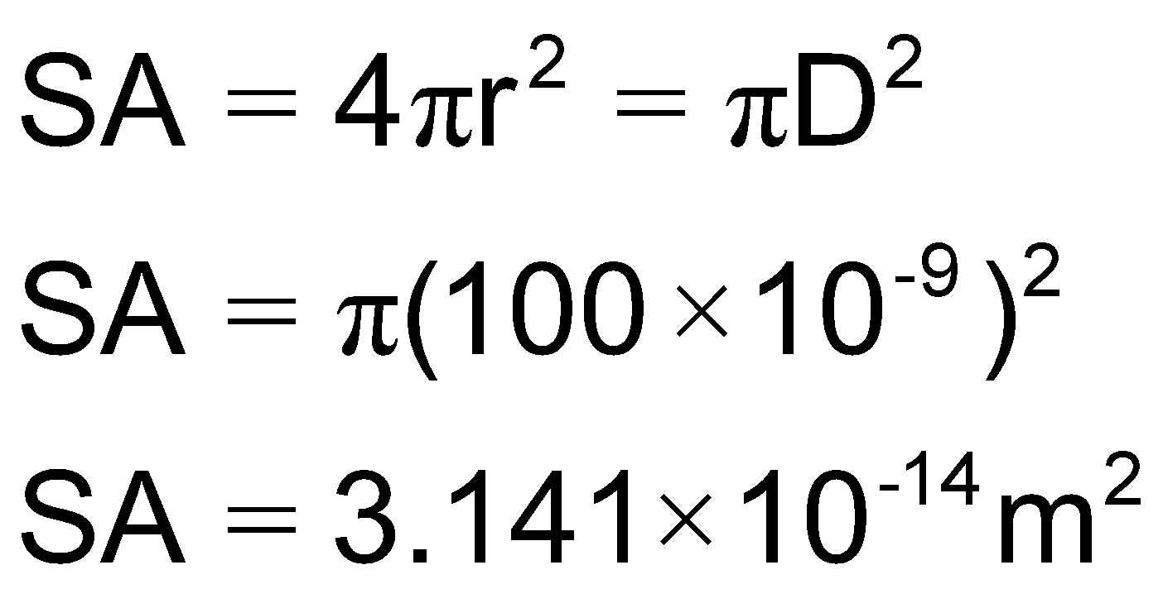
Volume :
Surface Area :
This gives an approximate surface area to volume ratio of >10⁷:1 which is significantly larger than a macro sized particle. As the surface area to volume ratio increases so does the percentage of atoms at the surface and surface forces become more dominant.

Slide 8
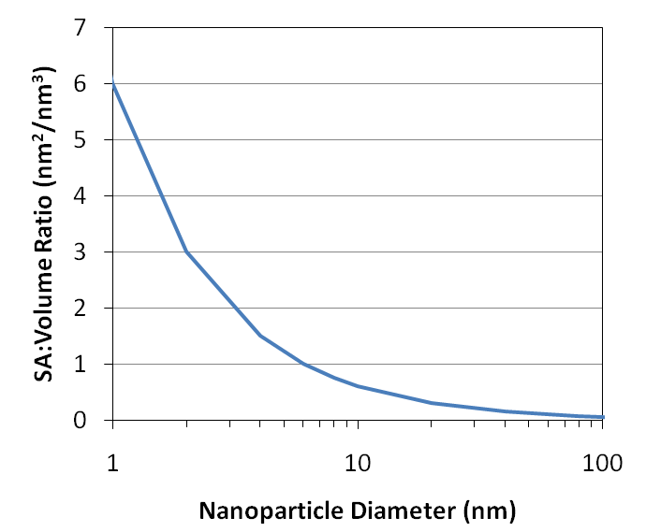
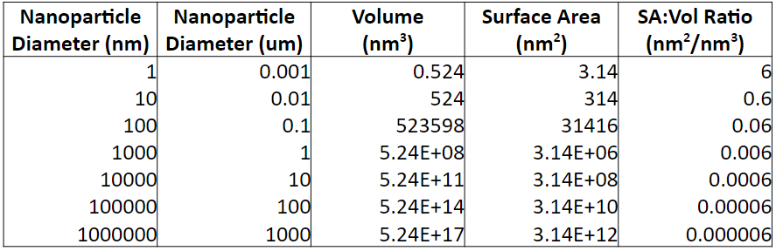

Slide 9
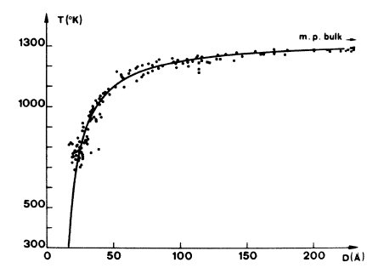
Melting Point
Nanoparticles have a lower melting point than their bulk counterparts.
Particles: May sinter together at lower than expected temperature.
Rods: Can melt and form spherical droplets if heated too high.
Films: Thin films can form pin-holes. Continued heating can lead to de-wetting behavior and island formation.

Slide 10
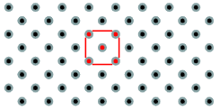
Crystal Structure
Most solids are crystalline with their atoms arranged in a regular manner. This arrangement of atoms impacts the functionality of the material. Some solids have this order presented over a long range as in a crystal.
Amorphous materials such as glass and wax lack long range order, but they can have a limited short range order, defined as the local environment that each atom experiences.
The spatial arrangement of atoms in a crystal lattice is described by its unit cell.

Slide 11
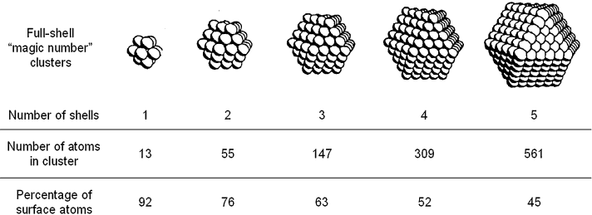
Magic Number
Nanoparticles have a “structural magic number”, that is, the optimum number of atoms that leads to a stable configuration while maintaining a specific structure.
Structural magic number = minimum volume and maximum density configuration
If the crystal structure is known, then the number of atoms per particle can be calculated.
Percentage of surface atoms decreases as cluster grows

Slide 12
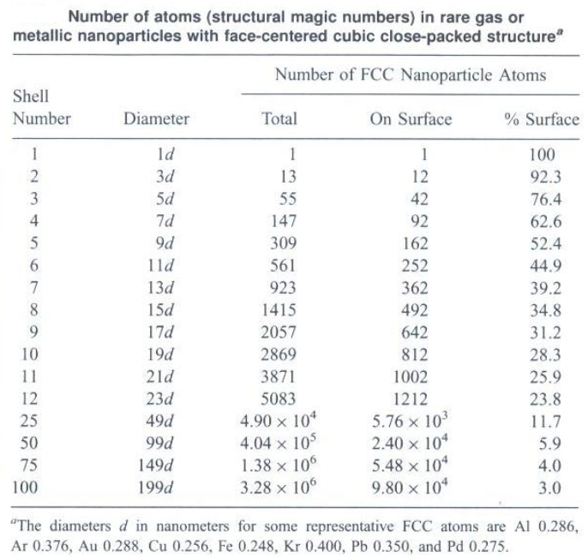
Number of atoms (y) in shell (n):
y = 10n² + 2 (n = 1,2,3…)
For n layers, the number of atoms N in an approximately spherical FCC nanoparticle is given by the following formula:
N = 1/3[10n³ – 15n² + 11n - 3]
The number of atoms on the surface N_{surf}
N_{Surf} = 10n² – 20n +12

Slide 13
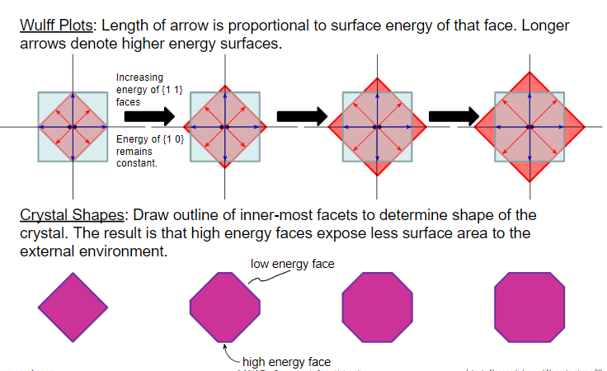
Wulff Crystal Shapes
It is used to determine the shape of a crystal when formed under thermodynamic equilibrium conditions. Surfaces are basically areas of high energy. Different faces have different surface energies.
The shape of an equilibrium crystal is obtained minimizing the total surface free energy associated with the crystal-medium interface.

Slide 14
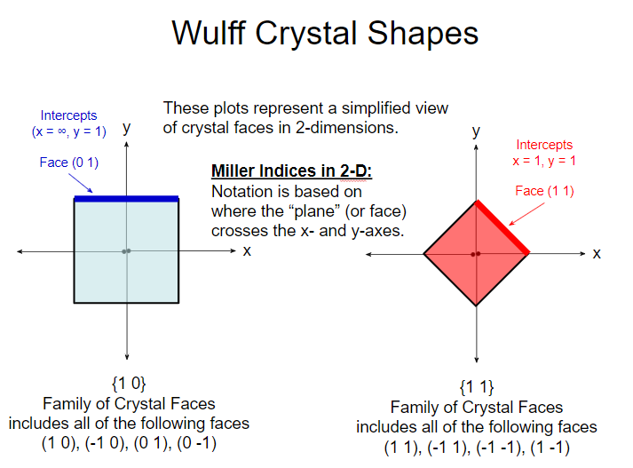

Slide 15

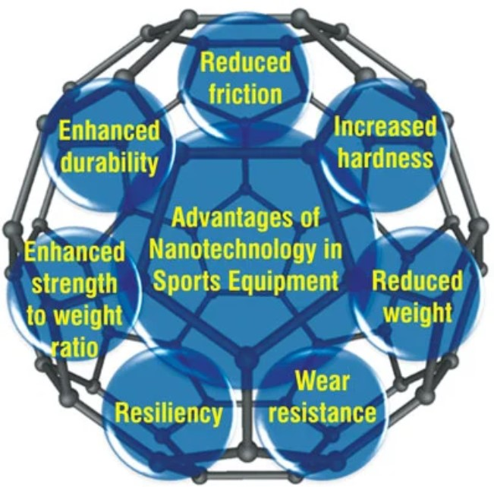
Uses of Nanomaterials
Paints : Nanoscale titanium dioxide and silicon dioxide are widely used in the paint industry. synthetic amorphous silica can improve the hardness, abrasion, scratch and weather resistance of paint.
Sports Industry : The sports industry has been producing baseball bats that have been made with carbon nanotubes. Nanoclay linings are found in footballs and tennis balls Sport clothing, particularly football kits, have also benefited from nanotechnology – those smelly socks are a breeding ground for fungi and bacteria.

Slide 16
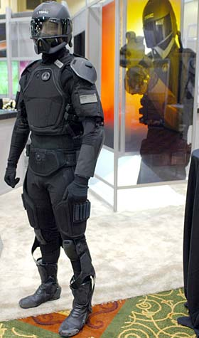
Military : Nanomaterials have also been developed for use in the military. One example is the use of mobile pigment nanoparticles being used to produce a better form of camouflage. Additionally, the military have developed sensor systems using nanomaterials
Nanomaterials in Biomedical Purposes :
Nanoscale devices are one hundred to ten thousand times smaller than human cells. They are similar in size to large biological molecules such as enzymes and receptors. Because of their small size, nanoscale devices can readily interact with biomolecules on both the surface and inside cells. By gaining access to so many areas of the body, they have the potential to detect disease and deliver treatment in ways unimagined before now.

Slide 17
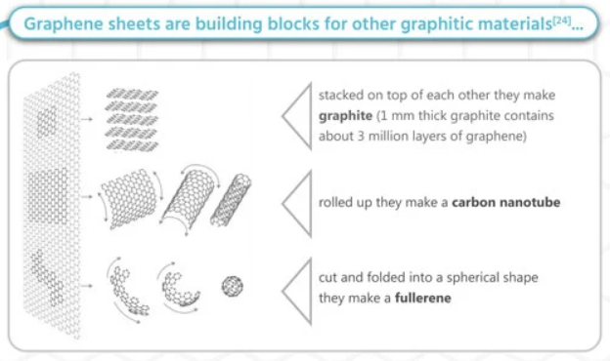
Graphene
The carbon-based material is nearly 200 times stronger than steel, flexible, nearly transparent, and highly conductive to heat and electricity.
Since graphene is just a single layer of carbon atoms connected in a hexagonal pattern, it is also extremely thin and lightweight, and therefore an attractive material for nanotechnology applications.
Improves both energy capacity and charge rate in rechargeable batteries.
Activated graphene makes superior supercapacitors for energy storage.
Graphene electrodes may lead to a promising approach for making solar cells that are inexpensive, lightweight and flexible. Multifunctional graphene mats are promising substrates for catalytic systems.

Slide 18
Nanotechnology and Future Aspects
This technological branch manipulates the molecular structure of materials to change their intrinsic properties and obtain others with revolutionary applications. It is helping to considerably improve, and revolutionize almost every sector.
On the one hand, the sector is expected to grow globally, driven by technological advances, increased government support, increased private investment and growing demand for smaller devices, to name a few. However, the environmental, health and safety risks of nanotechnology and concerns related to its commercialisation could hamper market expansion.
The next 15-20 years will show an evolutionary leap with the assistance of nanotechnology.

Slide 19
THANK YOU

